Slide 1

Shark Angels
Gabriella Alves, Jeremy Patole, Pablo Rivera

Slide 2
The data
Notes:
Highlighting how the app supports business operations by enhancing safety protocols, risk assessment, and customer confidence.

Slide 3
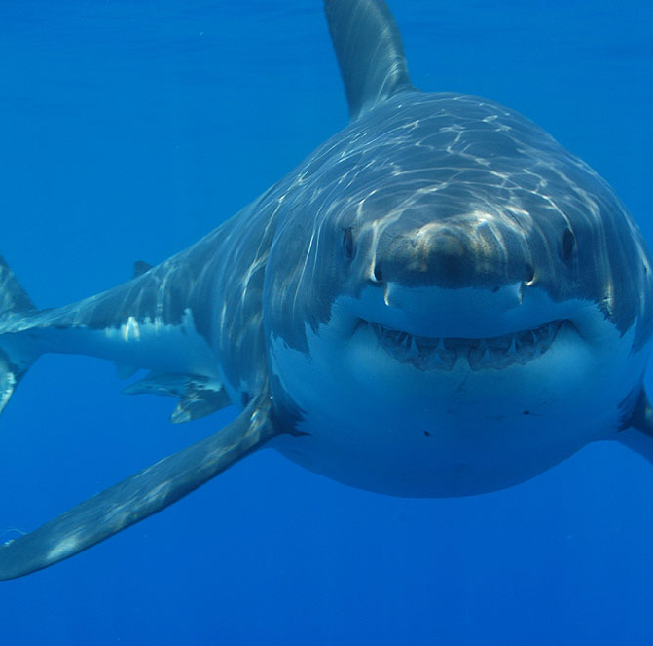
Global shark attack files
All the information used here comes from Shark Research Institute
A nonprofit organization founded in 1991 by Marie Levine with the mission to study and protect sharks and their habitats through research and public education.
Notes:
--- Shark incidents, though rare, have significant impact on public safety and business risk. Currently, shark attack data is fragmented, creating a gap in timely information for insurers, travelers, and sports organizers. Image source: Microsoft 365 content library

Slide 4
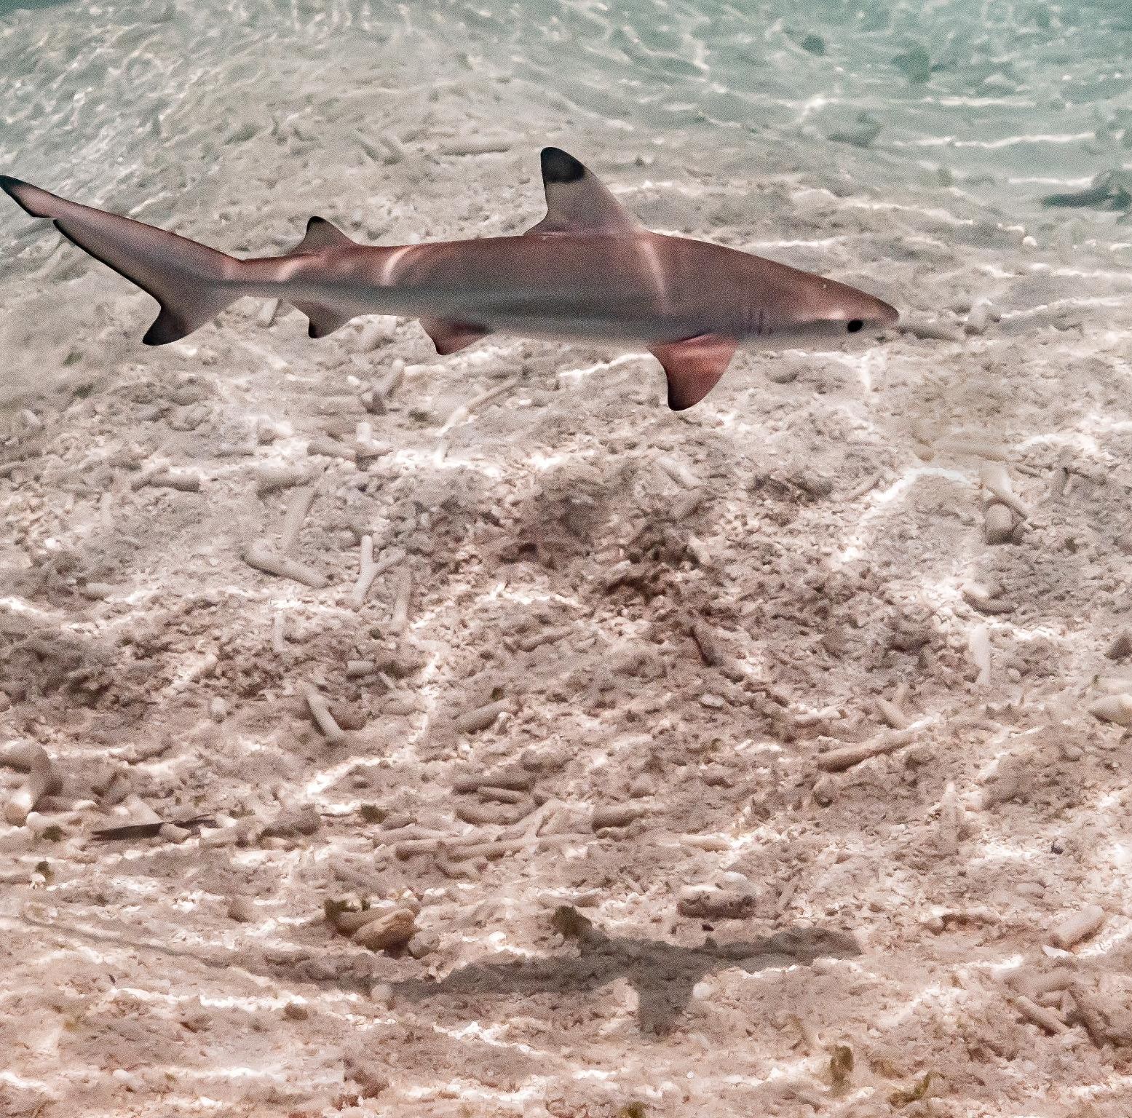
Importance of Global Shark Attack Data
Impact on Public Safety
Shark attacks, though rare, pose serious safety concerns for coastal communities. Incidents have been recorded in over 120 countries worldwide.
Timing
78% of attacks were unprovoked, and more than half occurred during the afternoon — when beach and water activities peak.
Business and Insurance Risk
Shark-related incidents increase operational risks for insurance providers, tourism agencies, and aquatic sports companies.
Need for Data Integration
The absence of centralized global shark data delays safety alerts and hinders decision-making for travelers and event organizers.
Notes:
--- Shark incidents, though rare, have significant impact on public safety and business risk. Currently, shark attack data is fragmented, creating a gap in timely information for insurers, travelers, and sports organizers. Image source: Microsoft 365 content library

Slide 5
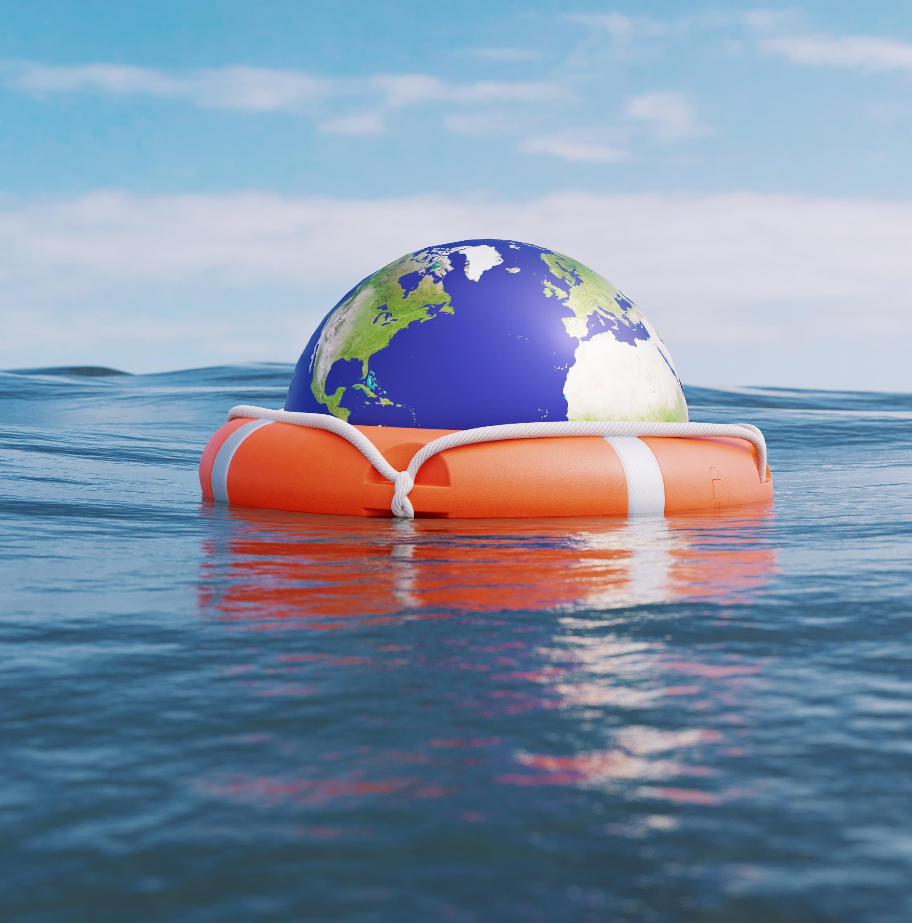
Challenges
Lack of data
The main difficulties in dealing with shark attack data are the extreme rarity of attacks, making statistical analysis unreliable,
Consistent
Detailed reporting and the difficulty in identifying specific causal factors due to limited scientific agreement on influences like human and shark population dynamics.
Additionally, the media often oversimplifies or sensationalizes attacks, leading to a public perception that is not supported by the low statistical probability.
Notes:
--- The app is tailored for insurance companies managing risk, travel and sports agencies organizing activities near water bodies, and individuals seeking awareness and safety during water-related activities. Image source: Microsoft 365 content library

Slide 6
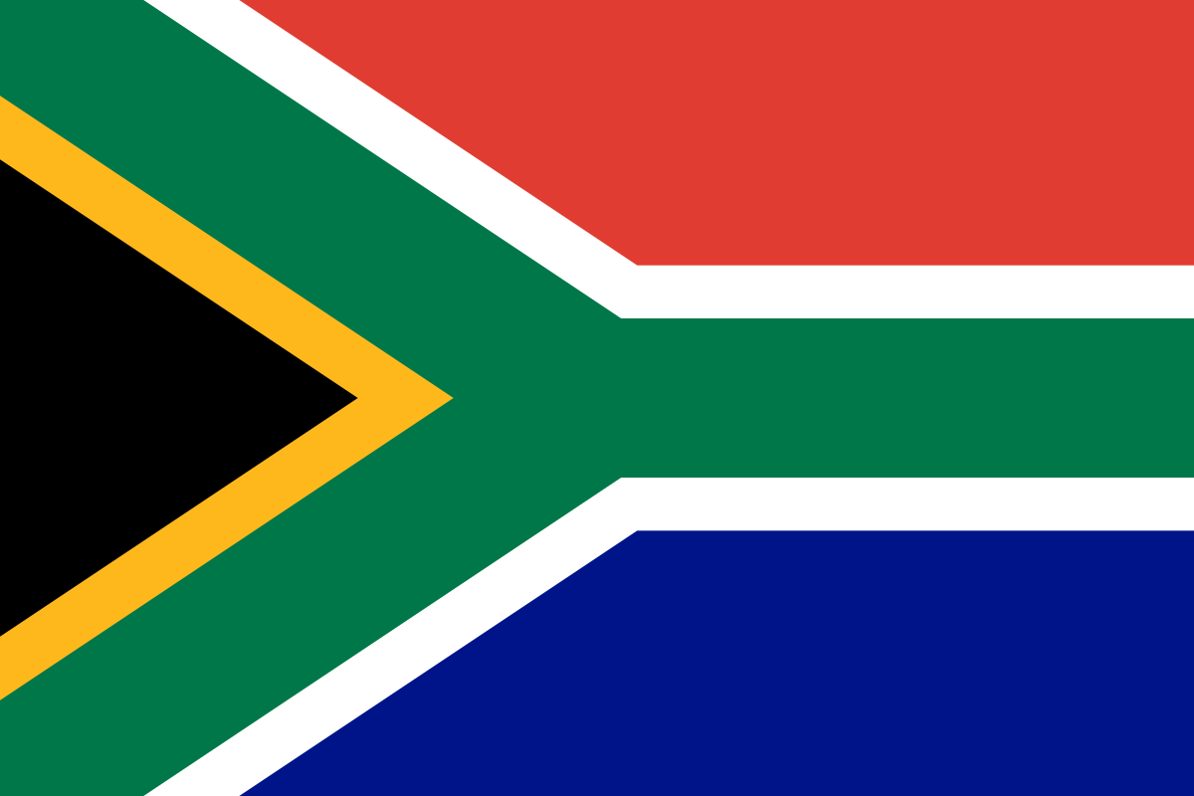

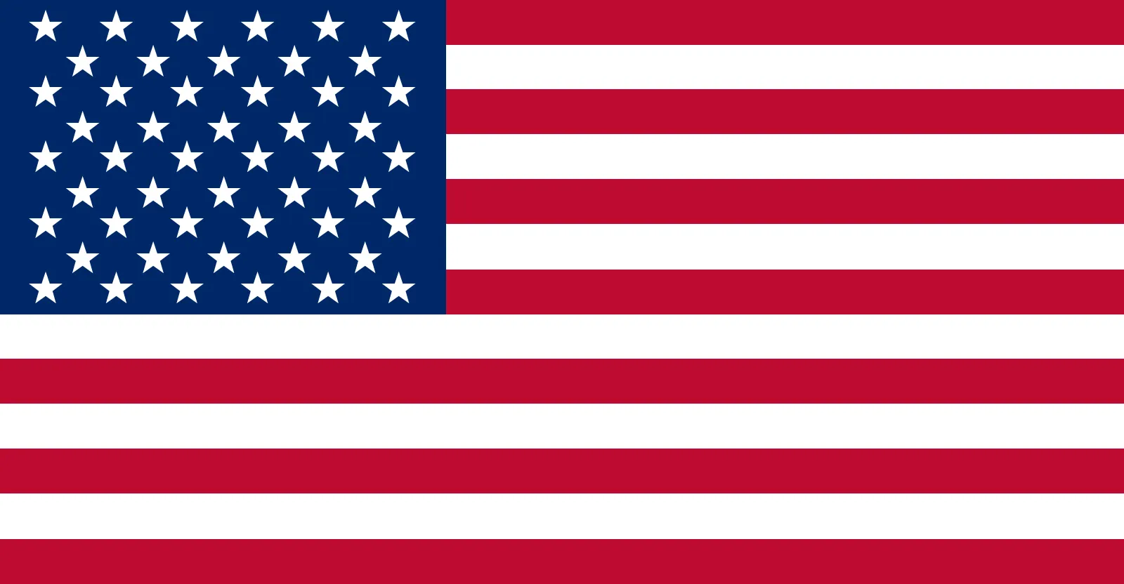
Global data, local worries
Shark attacks may seem like global phenomena, but their impact is highly regional, affecting tourism, safety perceptions, and local economies differently.
Bad propaganda
Although the Great White Shark is often portrayed as the ultimate villain, data reveals that species type isn’t the main risk factor. Behavior and timing matter more than the shark itself.
Vacation nightmare
Out of 7,000+ recorded shark attacks, three countries account for over 60% of all cases — showing that danger isn’t evenly distributed around the world.
Macho much?
A striking 87.5% of attacks involve men, highlighting the need for targeted awareness among this demographic — and maybe a reminder to take more calculated risks.
Notes:
--- The app provides live mapping of shark sightings and attacks, instant alerts to users in affected areas, and in-depth analytics to help users make informed safety decisions. Image source: Microsoft 365 content library

Slide 7
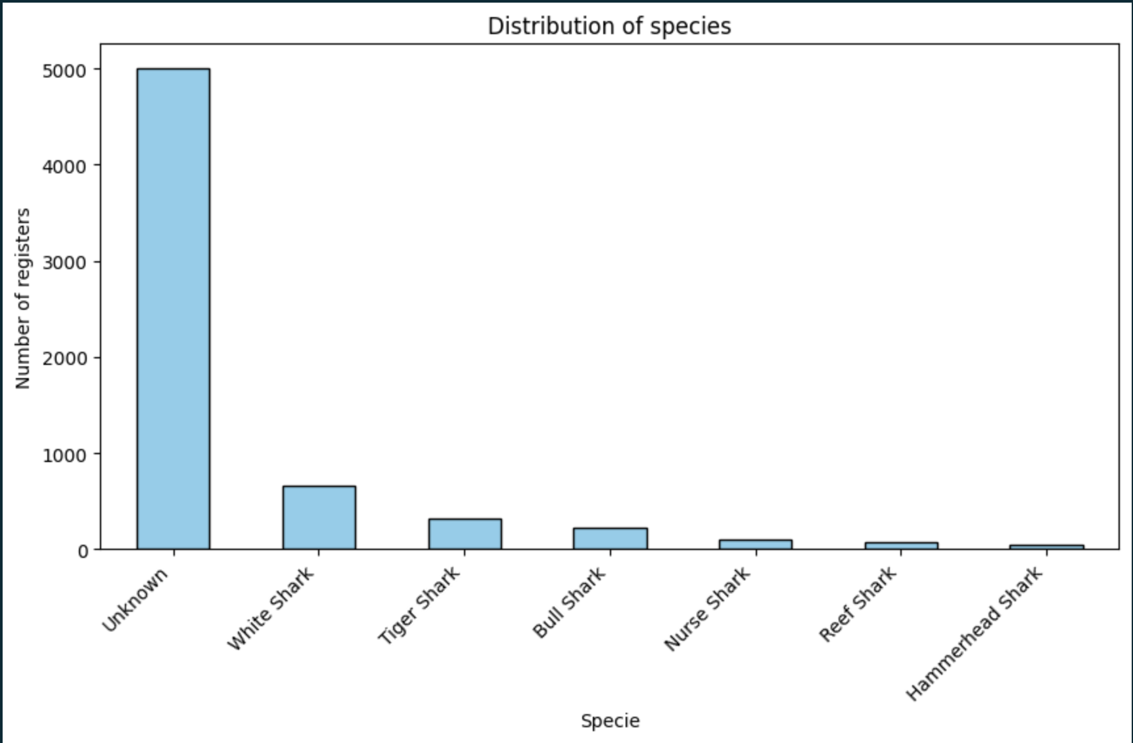
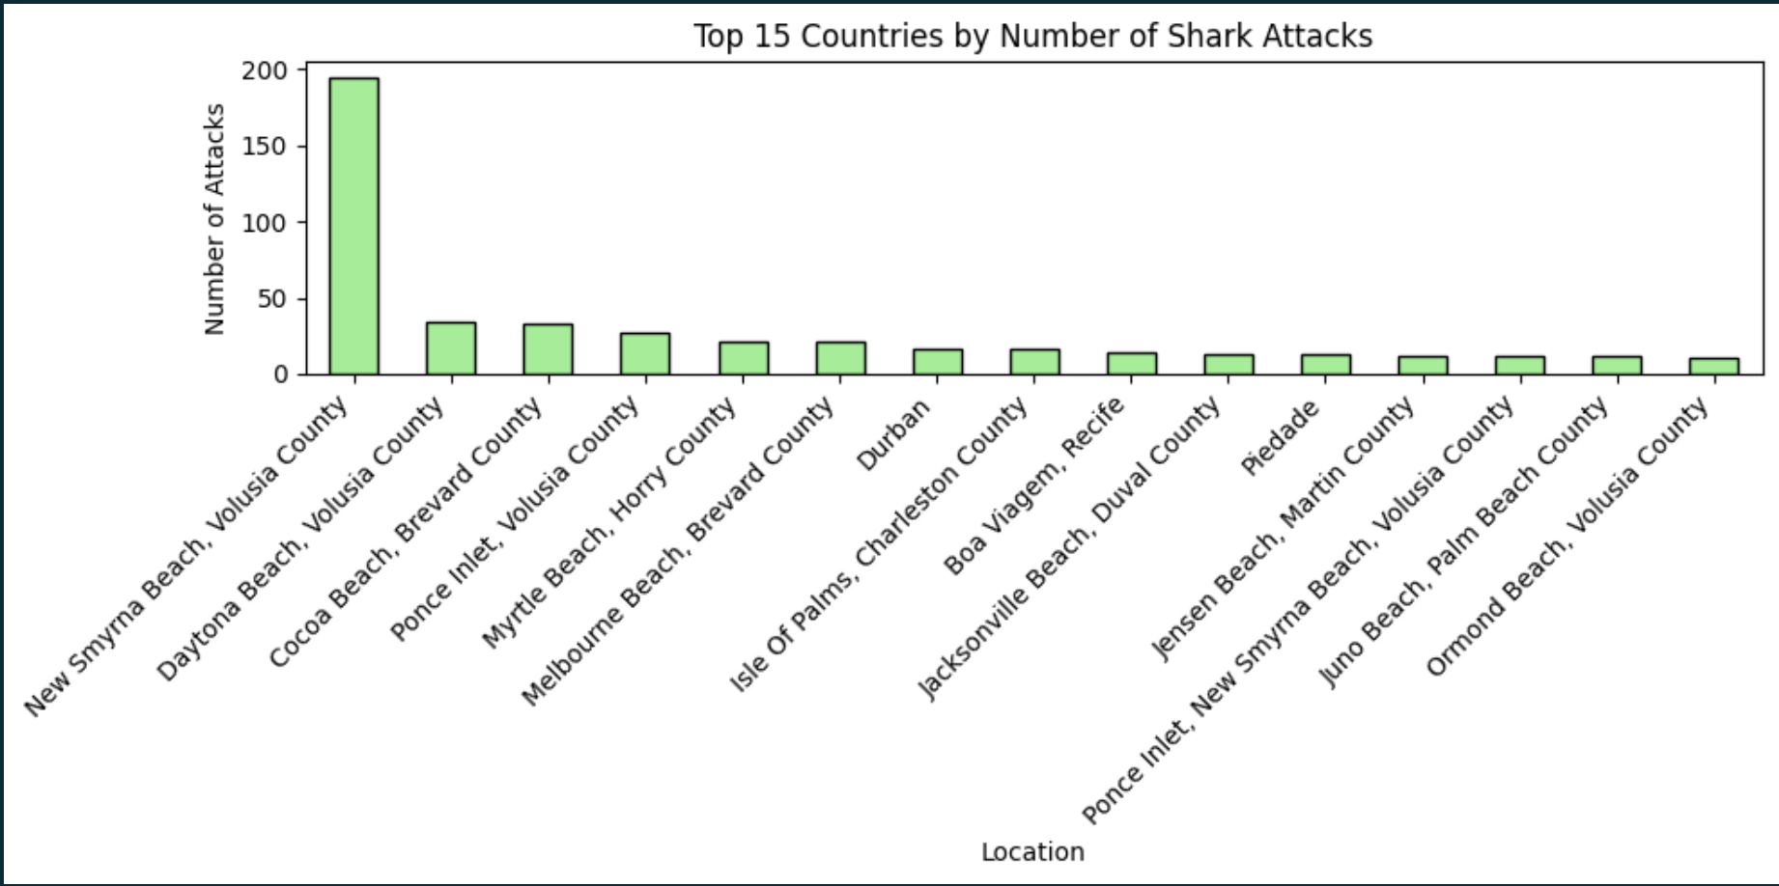
The data
Notes:
Highlighting how the app supports business operations by enhancing safety protocols, risk assessment, and customer confidence.

Slide 8
Global Shark Attack Mapping App
Notes:
AI-generated content may be incorrect. --- This presentation introduces an innovative Shark Attack Mapping App designed to provide real-time data and analytics to enhance safety and decision-making for insurance companies, travel agencies, sports organizations, and concerned individuals worldwide.

Slide 9
Target Audience
Insurance Companies
Insurance companies use the app to manage risk related to water activities and ensure client safety.
Risk assessment by region/activity, premium adjustments.
Travel and Sports Agencies
Travel and sports agencies organize water-based activities and use the app to enhance safety protocols.
Safety recommendations, low-risk destination marketing.
Concerned Individuals
Individuals engage with the app to increase awareness and stay safe during water-related recreational activities.
Notes:
--- The app is tailored for insurance companies managing risk, travel and sports agencies organizing activities near water bodies, and individuals seeking awareness and safety during water-related activities. Image source: Microsoft 365 content library

Slide 10
Mapping
View locations of shark sightings and attacks through interative maps, keeping users constantly informed of nearby risks.
Alerts
Receive notifications as new attacks are recorded, ensuring travelers, lifeguards, and water sport enthusiasts stay updated daily.
In-Depth Analytics
Explore data trends such as:
Most frequent attack hours,
Shark species involved,
Risk levels by location.
Notes:
--- The app provides live mapping of shark sightings and attacks, instant alerts to users in affected areas, and in-depth analytics to help users make informed safety decisions. Image source: Microsoft 365 content library

Slide 11
Personal challenges
Notes:
Highlighting how the app supports business operations by enhancing safety protocols, risk assessment, and customer confidence.

Slide 12
Pablo Inconsistent and ambiguous data. Increased complexity. Interlinking cleaned columns for analytical relevance.
Gabriella
I bit off more than I could chew (fuzzy wuzzy). Took to long to understand the deliverables. Again, time management.
Jeremy
Understanding regular expression (regex).
Dealing with non numerical variables and understanding their importance.
Notes:
--- Shark incidents, though rare, have significant impact on public safety and business risk. Currently, shark attack data is fragmented, creating a gap in timely information for insurers, travelers, and sports organizers. Image source: Microsoft 365 content library

Slide 13
Shark Angels
THANK YOU!
Gabriella Alves, Jeremy Patole, Pablo Rivera

